Slide 1
Cluster Analysis

Slide 2
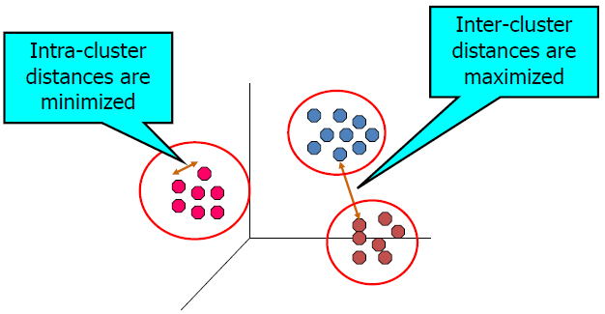
What is Cluster Analysis ?
Cluster analysis is
A type of unsupervised learning method
Clustering is the grouping of objects such that
The objects in a group (cluster) are similar (or related) to
one another and
Different from (or unrelated to) the objects in other groups
Based on a similarity measure

Slide 3
Applications of Cluster Analysis
Applications
Group related documents for browsing
Group genes and proteins that have similar functionality
Group stocks with similar price fluctuations
Etc.
• Summarization
Reduce the size of large data sets

Slide 4
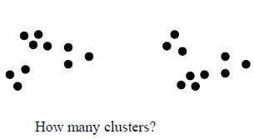
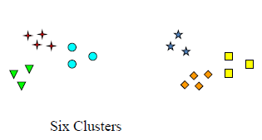
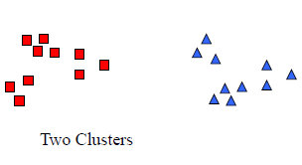
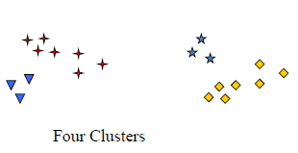
Notion of a Cluster can be Ambiguous

Slide 5
Types of Clustering
Different types of Clustering
Density-Based Clustering
Hierarchical Clustering
Partitioning Clustering
Grid-Based Clustering
Model-based Clustering
Sub-space Clustering

Slide 6
Clustering :: Similarity Measures
In Data Mining
The similarity measure is
A distance with dimensions describing object features
If the distance among two objects is small
There is a high degree of similarity among the objects
Else vice versa
The concept of similarity is
Subjective and depends heavily on the context

Slide 7
Clustering :: Similarity Measures
Clustering is done based on
A similarity measure to group similar objects together
The similarity measure is most commonly based on
Distance functions such as
Euclidean distance
Manhattan distance
Minkowski distance
Cosine similarity, etc.

Slide 8
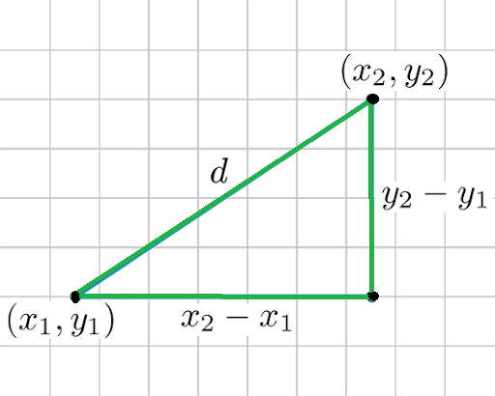
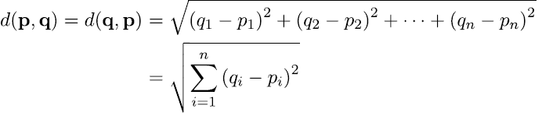
Similarity Measures::Euclidean Distance
The traditional metric
For problems with geometry
It can be simply explained as
The ordinary distance between two points
One of the most used measure in the cluster analysis
Mathematically, it can be computed as
The root of squared differences between the
coordinates between two objects

Slide 9
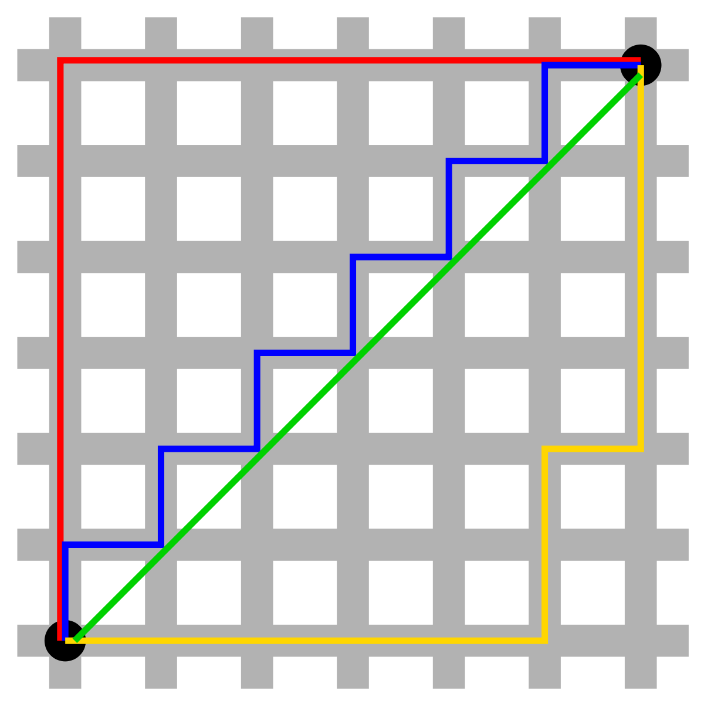
Similarity Measures::Manhattan distance
Determines the absolute difference
Among the pair of the coordinates
Suppose, In a plane, we have
Two points P at coordinate (x1, y1) and Q at (x2, y2)
To determine the distance between these points
Have to calculate the perpendicular distance of the
points from X-axis and Y-Axis
Manhattan distance between P and Q is
d(P, Q) = |x1 – x2| + |y1 – y2|

Slide 10
Similarity Measures:: Minkowski distance
The generalized form of
The Euclidean and Manhattan Distance Measure
In an n-dimensional space, a point is represented as
(x₁, x₂, ..., x_{n})
Consider two points P₁ and P₂
P₁ : (X₁, X₂, ..., X_{n})
P₂ : (Y₁, Y₂, ..., Y_{n})
Then, the Minkowski distance between P₁ and P₂ is given as
d(P_{1,} P₂) =
When p = 2
Minkowski distance is same as the Euclidean distance
When p = 1
Minkowski distance is same as the Manhattan distance

Slide 11
Similarity Measures::Cosine similarity
Cosine similarity is a metric
Helpful in determining
How similar the data objects are irrespective of their size
In cosine similarity
Objects in a dataset are treated as a vector
The formula to find the cosine similarity between two vectors
Cos(x, y) = x . y / ||x|| * ||y|| Where,
x . y = Dot product of the vectors x and y
||x|| and ||y|| = Length of the two vectors x and y
||x|| * ||y|| = Cross product of the vectors x and y
Advantages
Even if the two similar objects are far apart by the Euclidean distance
because of the size, they could still have a smaller angle between them
Smaller the angle, higher the similarity
When plotted on a multi-dimensional space, the cosine similarity captures
the orientation (the angle) of the objects but not the magnitude.

Slide 12
Similarity Measures::Cosine similarity
To find the Cosine Similarity between two vectors
x = { 3, 2, 0, 5 } and y = { 1, 0, 0, 0 }
The formula for calculating the cosine similarity is
Cos(x, y) = x . y / ||x|| * ||y||
Therefore,
x . y = 3*1 + 2*0 + 0*0 + 5*0 = 3
||x|| = √ (3)^2 + (2)^2 + (0)^2 + (5)^2 = 6.16
||y|| = √ (1)^2 + (0)^2 + (0)^2 + (0)^2 = 1
∴ Cos(x, y) = 3 / (6.16 * 1) = 0.49
The dissimilarity between the vectors x and y is given by
∴ Dis (x, y) = 1 - Cos(x, y) = 1 - 0.49 = 0.51
The cosine similarity between two vectors is measured in θ
If θ = 0°, the vectors are similar
If θ = 90°, the vectors are dissimilar

Slide 13
Clustering Algorithms :: K-Means
K-Means is
An Unsupervised Learning algorithm
Follows partitional approach
Groups the unlabeled dataset into K different clusters
where, K is the pre-defined number of clusters
Each cluster is associated with a centroid
Each point is assigned to the cluster with the closest
centroid
The objective is to minimize the sum of distances of
the points to their respective centroid

Slide 14
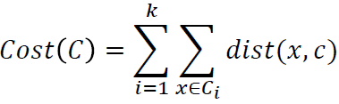
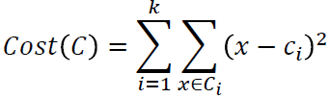
Clustering Algorithms :: K-Means
Problem :
Given a set X of n points in a d-dimensional space and
An integer K, to group the points into K clusters as
C = {C₁, C₂,…,C_{k}}
such that
Sum of Squares Error (SSE) function
is minimized, where C_{i} is the mean (centroid) of the
cluster C_{i} and i = 1, 2, 3,…., k

Slide 15
Clustering Algorithms :: K-Means
Algorithm
Select k points as initial centroids
Repeat
Form k clusters by assigning all points to the closest centroid
Recompute the centroid of each cluster
Until the centroids do not change
Initialization
Initial centroids are often chosen randomly.
Clusters produced vary from one run to another.

Slide 16
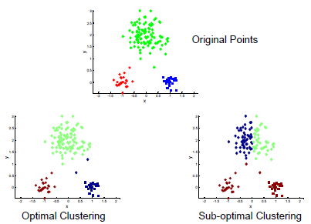
Clustering Algorithms :: K-Means Results

Slide 17
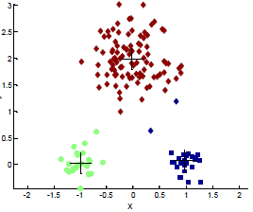
Clustering Algorithms :: K-Means Results

Slide 18
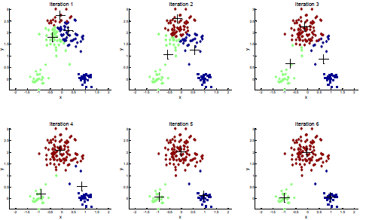
Clustering Algorithms:: K-Means Results

Slide 19
Clustering Algorithms::K-Means
Dealing with Initialization
Strategies
• Do multiple runs
Select the clustering result with the smallest error
Select original set of k centroids
By methods other than random
E.g., pick the most distant (from each other)
points as initial cluster centroids

Slide 20
Clustering Algorithms::K-Means
Convergence
K-means will converge for common similarity measures
Such as Euclidean distance (SSE), cosine similarity,
correlation, etc.
Most of the convergence happens in the first few iterations
Often the stopping condition is changed to ‘Until relatively
few points change clusters’
Complexity is O( n * K * I * d ), where
n = number of points, K = number of clusters,
I = number of iterations, d = dimensionality
In general, a fast and efficient algorithm

Slide 21
Clustering Algorithms::K-Medoids
A partitioning algorithm
Similar to k-Means
Uses medoids instead of centroids
k-medoids minimizes the sum of dissimilarities
Between points labeled to be in a cluster and a point
designated as the center of that cluster
Medoids are most centrally located Object

Slide 22
Clustering Algorithms::
Clustering Large Applications based on RANdomized Search (CLARANS)
A partitioning method of clustering
To recognize patterns and relationships
That exist in spatial data such as
Distance-related
Direction-relation
Topological data

Slide 23
Clustering Algorithms:: Steps of CLARANS
Initially, select k random data points and label them as medoids
Select a random point, x from the set of medoids, and another point, y which is not in that set of medoids
Compute the sum of distances for the points x and y from all other points
If the sum of distances from all other points for point y is less than that for point x, replace x with y
Perform such a randomized search of medoids n times where n denotes the number of local minima computed, i.e. number of iterations to be performed, which is specified as a parameter

Slide 24
Clustering Algorithms:: Steps of CLARANS
The set of medoids obtained after such n number of iterations is termed as local optimum
A counter is incremented
Every time a replacement of points is made
The process of examining the points for possible replacement is repeated till the counter does not exceed the maximum number of neighbors to be examined (specified as a parameter)
The set of medoids obtained when the algorithm stops is
The best local optimum choice of medoids

Slide 25
Clustering Algorithms
Hierarchical Clustering
Two main types
Agglomerative
• Start with the points as individual clusters
• At each step, merge the closest pair of clusters until
only one cluster (or k clusters) left
Divisive
• Start with one cluster including all points
• At each step, split a cluster until each cluster contains
a point (or there are k clusters)
• Traditional hierarchical algorithms use a similarity matrix
Merge or split one cluster at a time

Slide 26
Clustering Algorithms
Advantages of Hierarchical Clustering
Do not have to assume any particular number of clusters
Any desired number of clusters can be obtained by
‘Cutting’ the dendogram at the proper level
They may correspond to meaningful taxonomies
Example in biological sciences e.g., animal kingdom

Slide 27
Clustering Algorithms
Balanced Iterative Reducing and Clustering Using Hierarchies (BIRCH)
Is more suitable for very large databases and the number of categories K is relatively large
Runs very fast
Needs only a single pass to scan the dataset for clustering
Uses a tree structure to create a cluster
Generally called the Clustering Feature Tree (CF Tree)
Each node of this tree is composed of several Clustering features (CF)

Slide 28
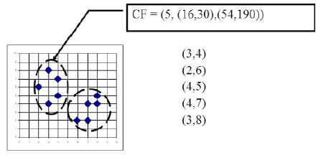
BIRCH :: Clustering feature (CF)
Given, N d-dimensional data points in a cluster
{X_{i}} where i = 1, 2, …, N
then, clustering feature is defined by a triplet
CF = ( N, LS, SS )
where
N is the number of data points in the cluster
LS is the linear sum of the N data points
SS is the square sum of the N data points

Slide 29
BIRCH :: Clustering feature (CF)
CF is a compact storage
For data on points in a cluster
Has enough information
To calculate the intra-cluster distances
Additivity theorem allows
To merge sub-clusters

Slide 30
BIRCH :: CF Aditivity Theorem
If the CF entries of two disjoint sub-clusters are
CF1 = (N1, LS1, SS1) and CF2 = (N2 ,LS2, SS2)
The CF entry of the cluster (parent) formed
By merging the two disjoint sub-clusters is
CF = CF1 + CF2
= (N1 + N2 , LS1 + LS2, SS1 + SS2)
Summarized information for a single cluster
Summarized information for two clusters
Additive Theorem helps to merge sub-clusters

Slide 31
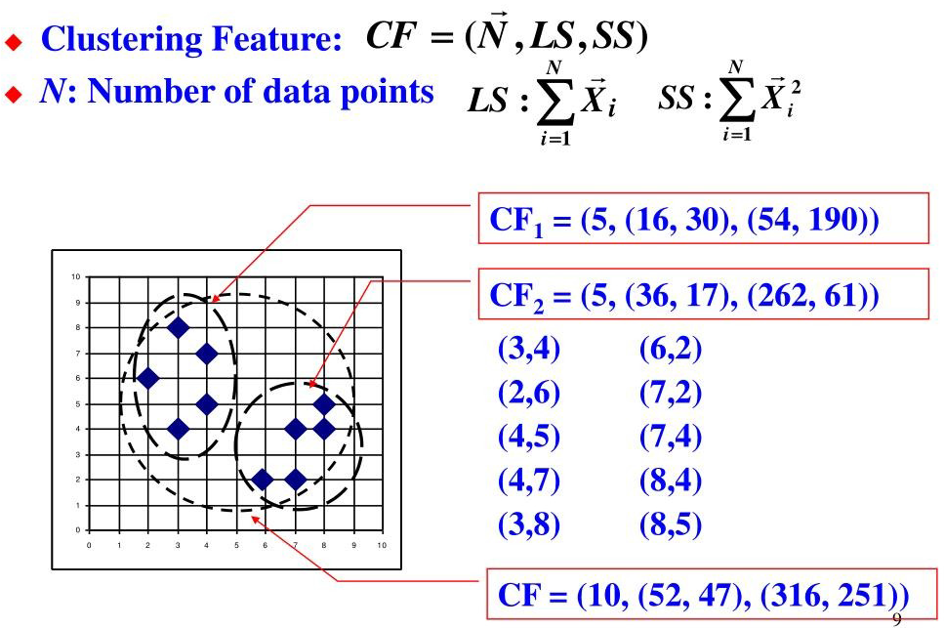
BIRCH :: Example of using CF Vectors

Slide 32
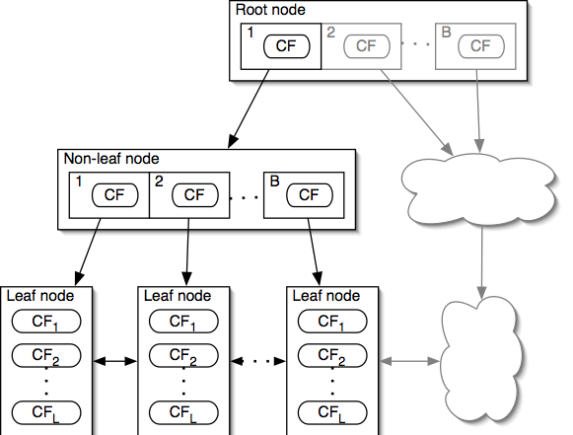
BIRCH :: CF Tree Properties
An alternative representation of the dataset
Each non-leaf node has at most B entries
Each leaf node has at most L CF entries
Each have diameter, at most T
Node size is determined by
Dimensionality of data space
Input parameter, P (page size)

Slide 33
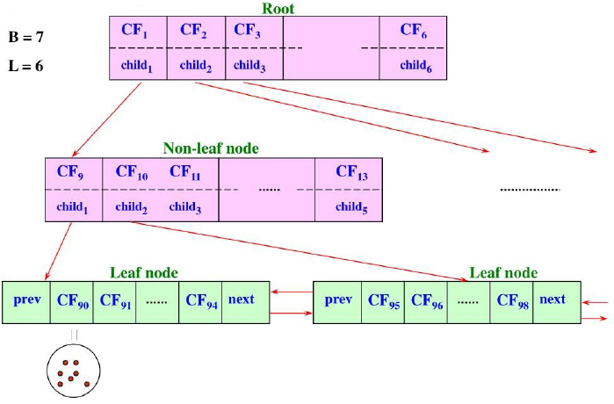
BIRCH :: Example of CF Tree

Slide 34
BIRCH :: Insertion in CF Tree
Identifying the appropriate leaf
Recursively descending the CF tree
Choose the closest child node according to a chosen
distance metric
Modifying the leaf
Test whether the leaf can absorb the node
Without violating the threshold
If there is no room
Split the node
Modifying the path
Update CF information up the path

Slide 35
BIRCH :: Algorithm
Phase 1
Scan all data and build an initial in-memory CF tree
Phase 2
Condense into Desirable length
By building a smaller CF tree
Phase 3
Global clustering
Phase 4
Cluster refining
This is optional
Requires more passes over the data to refine the results

Slide 36
BIRCH :: Algorithm
Phase 1
Start with initial threshold
Insert points into the tree
If run out of memory
Increase threshold value and rebuild a smaller tree
Good initial threshold is important
But hard to figure out
Removal of Outlier
When rebuilding tree remove outliers

Slide 37
BIRCH :: Algorithm
Phase 2
Optional
Phase 2 prepares the tree for phase 3
As phase 3 sometime have minimum size which performs well
Removes outliers and grouping clusters are performed

Slide 38
BIRCH :: Algorithm
Problems after phase 1
Input order affects results
Splitting triggered by node size
Phase 3
Cluster all leaf nodes according to the CF values
With an existing algorithm
Algorithm used here
Agglomerative hierarchical clustering

Slide 39
BIRCH :: Algorithm
Phase 4
Optional
Do additional passes over the dataset & reassign data points to the closest centroid from phase 3
Recalculating the centroids and redistributing the items
Always converges (no matter how many time phase 4 is repeated)

Slide 40
Clustering Algorithm
Density based Approach

Slide 41
Clustering Algorithm
Density based Approach
Major features
Discover clusters of arbitrary shape
Handle noise
Need density parameters as termination condition
Makes an assumption that
Clusters are dense regions in space separated by regions of lower density
Since clustering is performed based on dense connectivity
Can find clusters of arbitrary shapes

Slide 42
Clustering Algorithm
Density Based Spatial Clustering of Applications with Noise (DBSCAN)
This algorithm
Can find dense arbitrarily shaped clusters
Requires two input threshold parameters
Eps distance
Defines radius of the neighborhood region
minPoints
Defines the minimum number of points that should be contained within that neighborhood
Works well even with noisy datasets

Slide 43
Clustering Algorithm
DBSCAN
Characterization of points
• Core Point
If a point has more than a specified number of
points (MinPts) within a cricle of radius Eps
These points belong in a dense region and are at the
interior of a cluster
Border point
If a point has fewer than MinPts within Eps but is in the neighborhood of a core point
Noise point
A point which is not a core point or a border point

Slide 44
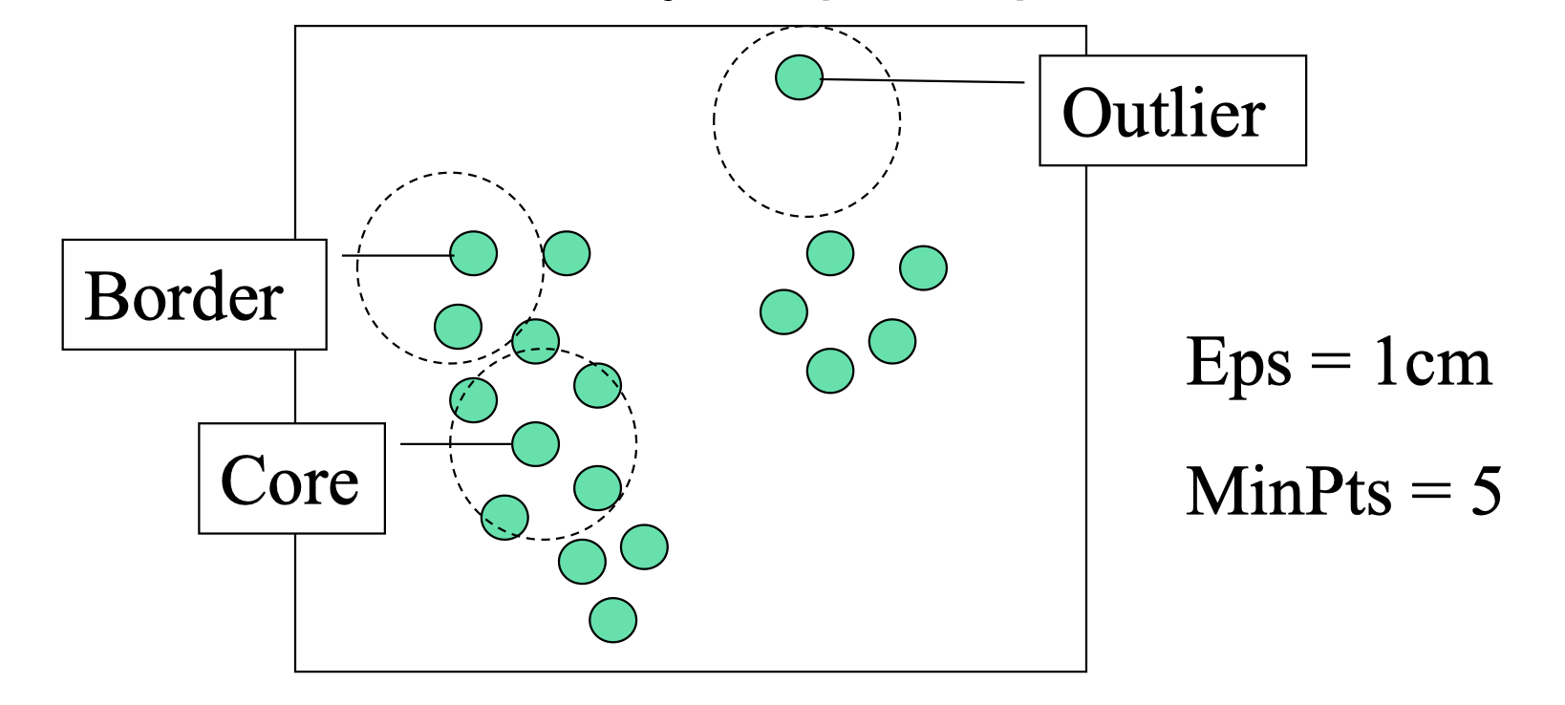
Clustering Algorithm :: DBSCAN

Slide 45
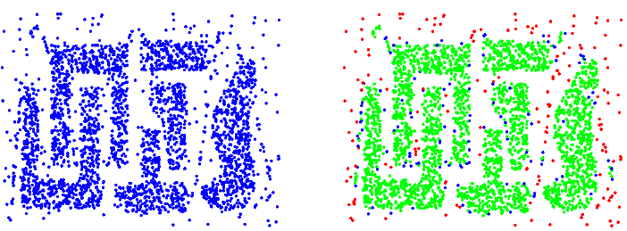
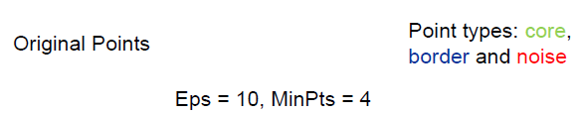
Clustering Algorithm
DBSCAN

Slide 46
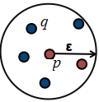
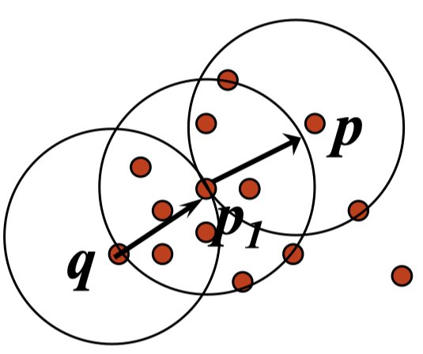
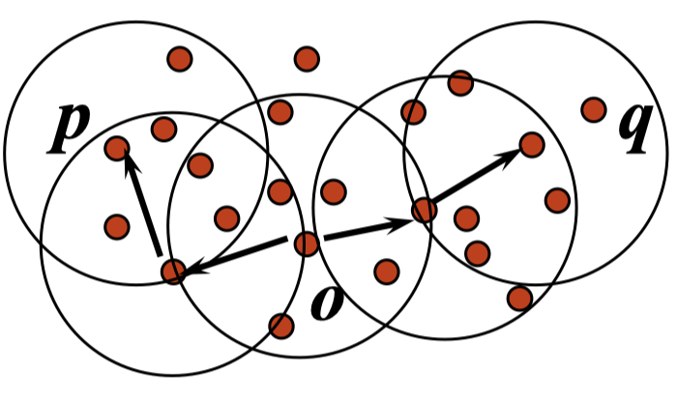
Clustering Algorithm :: DBSCAN
Density Concepts
Directly Density Reachable
A point q is Directly Density Reachable from
a point p if p is a core point and q ∈ N_{Eps}
Density Reachable
A point p is Density Reachable from a point q
w.r.t. Eps and Minpts, if there is a chain of points
p₁, p₂, …., p_{n}, p₁ = p and p_{n} = q such that p_{i+1} is
directly density reachable from p_{i}
Density Connected
A point p is Density connected to a point q
w.r.t. Eps and Minpts, if there is a point o,
such that both p and q are density reachable
from o w.r.t. Eps and Minpts

Slide 47
Clustering Algorithm :: DBSCAN
The algorithm proceeds
By arbitrarily picking up a point in the dataset
If there are at least minPoint points within a radius of ε to that point, then consider
All these points to be part of the same cluster
The cluster is then expanded
By recursively repeating the neighborhood calculation for each neighboring point
The algorithm continues
Until all points are classified
The complexity of this algorithm is
O(n²), where n is the number of points
O(n log n) with spatial indexing (kd-tree or r-tree)

Slide 48
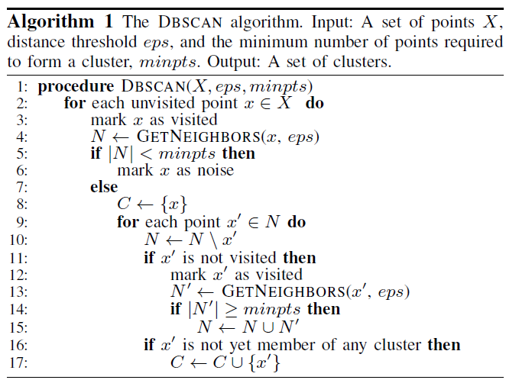
Clustering Algorithm
DBSCAN

Slide 49
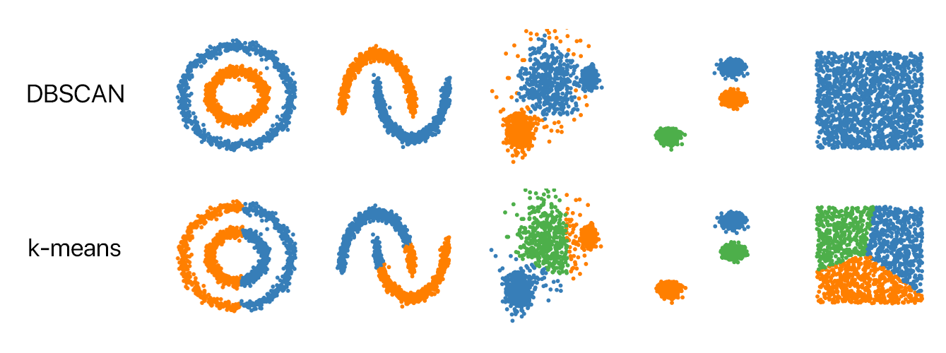
Clustering Algorithm
Results :: DBSCAN

Slide 50
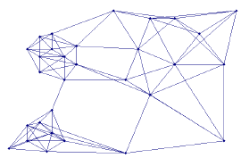
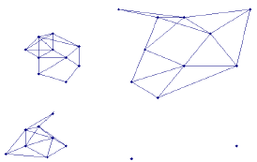
Clustering Algorithm
Graph Based Clustering
Transform the data into a graph representation
Vertices
The data points to be clustered
Edges are weighted
Based on similarity between data points
Graph partitioning
Each connected component
is a cluster

Slide 51
Clustering Algorithm
Graph Based Clustering
Two things needed
An objective function
To determine what would be the best way to cut the
edges of a graph
An algorithm to find the optimal partition (optimal
according to the objective function)

Slide 52

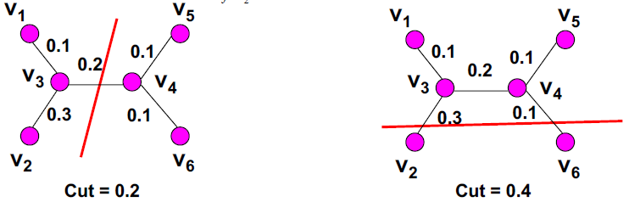
Clustering Algorithm::Graph Based Clustering
Objective Function for Partitioning
Suppose we want to partition the set of vertices V into
Two sets: V1 and V2
One possible objective function is
To minimize graph cut

Slide 53
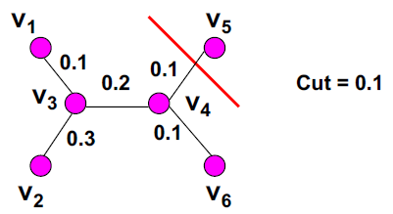
Clustering Algorithm::Graph Based Clustering
Objective Function for Partitioning
Limitation of minimizing graph cut
The optimal solution
Might be to split up a single node
From the rest of the graph
But, not a desirable solution

Slide 54
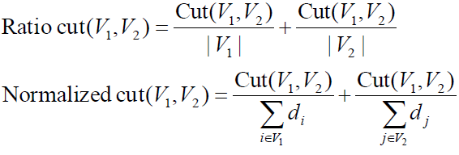

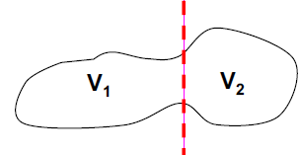

Clustering Algorithm::Graph Based Clustering
Objective Function for Partitioning
Should not only minimize the graph cut
But also look for balanced clusters

Slide 55
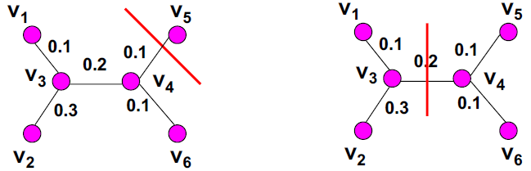
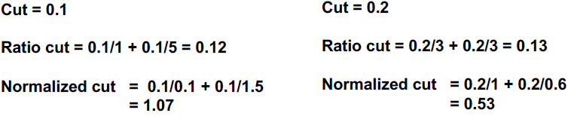
Clustering Algorithm::Graph Based Clustering
Example : Objective Function for Partitioning

Slide 56
Clustering Algorithm::Graph Based Clustering
Example : Objective Function for Partitioning

Slide 57
Clustering Algorithm::Graph Based Clustering
MST Clustering Algorithm
First construct MST(minimum spanning tree)
Using Kruskal algorithm and then
Set a threshold value and step size
Then, remove all those edges from the MST
Whose lengths are greater than the threshold value
Next, calculate and record
The ratio between the intra-cluster distance and inter-cluster distance and the threshold
Update the threshold value
By incrementing the step size
Every time a new (updated) threshold value is obtained
Repeat the above procedure
Stop repeating
When we encounter a situation such that the threshold value is maximum and as such no MST edges can be removed

Slide 58
Clustering Algorithm::Graph Based Clustering
MST Clustering Algorithm
In such situation
All the data points belong to a single cluster
Finally, the minimum value of the recorded ratio and
Form the clusters corresponding to the stored threshold value

Slide 59
Clustering Algorithm::Graph Based Clustering
MST Clustering Algorithm
Has two extreme cases
With the threshold value, zero
Each point remains within a single cluster
With the maximum threshold value
All the points lie within a single cluster
The algorithm searches for that optimum value of the threshold
For which the Intra-Inter distance ratio is minimum
The optimum value of the threshold
Must lie between these two extreme values of the threshold
In order to reduce the number of iteration
The initial threshold value should not be set to zero

Slide 60
Clustering Algorithm::Graph Based Clustering
MST Clustering Algorithm
Advantage
Comparatively better performance than
Algorithms like k-means
Disadvantage
Threshold value and step size
Needs to be defined apriori

